Slide 1
PRO
MESH
Notes:
Storyline, we want them to root for us to succeed. Maybe don’t start sections with so I am going to explain this area of the project. Idk if we should talk about how we’re going to be better than other companies, Erin did not like this. She said that the company and product should speak for itself. When talking about business operations

Slide 2

Logo 2
PRO
MESH

Slide 3

What is Waste?

Slide 4
Waste is any substance which is discarded after primary use, or is considered worthless, defective and of no use.

Slide 5
Our Focus
Eliminate usage of single-use plastic produce bags and other single use produce packaging

Slide 6
15, 000, 000, 000 bags
102, 000, 000 kilograms
12 minutes
1%
Notes:
https://www.biologicaldiversity.org/programs/population_and_sustainability/sustainability/plastic_bag_facts.html
https://www.quora.com/Why-are-the-average-ranges-for-cars-electric-newer-or-gas-always-around-300-400-miles
https://www.theverge.com/2019/6/10/18659644/canada-ban-single-use-plastics-bags-straws-2021
http://www.pristineplanet.com/eco-info/plastic-bag-facts-how-many-plastic-shopping-bags-do-we-use-each-year-and-more.asp

Slide 7
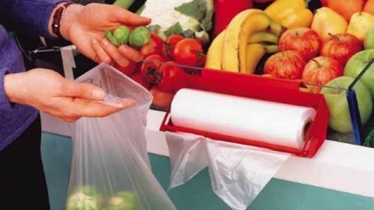
Legislature
Society
Notes:
There is currently a large opportunity for reducing packaging waste in Canada due to many reasons. Firstly, society is trying to steer away from single use packaging, especially in Canada. A majority of Canadians support a ban on single-use plastics, which includes the plastic produce bags that ProMesh is aiming to reduce . In a recent poll done by Nanos Research, 56% of Canadians support a total ban on single-use plastics, and 25% somewhat support a ban (Dickson, 2019). This means that the majority of Canadians will be willing to take alternate measures if a total ban is put into place in 2021, therefore providing an opportunity for a convenient solution such as ProMesh to be implemented. The legislature for this ban is already on its way, and has become a national issue in the past few years, following the similar actions taken by the European Union. A permanent ban for these single use plastics is entirely feasible, which will provide a large opportunity for reusable produce bags. As such, ProMes offers both convenience and the opportunity to reducing plastic waste at the same time.
Lastly, the service is very unique, as there are no current companies who offer a similar service. Promesh offers a relatively convenient method for consumers to reduce their plastic waste. Currently, consumers have to purchase their own produce bags and bring them every time to the grocery store to store the produce they purchase, and also have to clean the bags when they get dirty. With the introduction of the new service, consumers do not have to go through the trouble of using, cleaning, and potentially forgetting their own bags because we will provide them with high-quality mesh bags at their convenience. The consumers will be able to get their full deposit back when they return ProMesh bags. There is also an incentive for consumers to keep the bags and use them for other purposes, as the mesh bag is very versatile and can be useful for things like storing household objects.

Slide 8
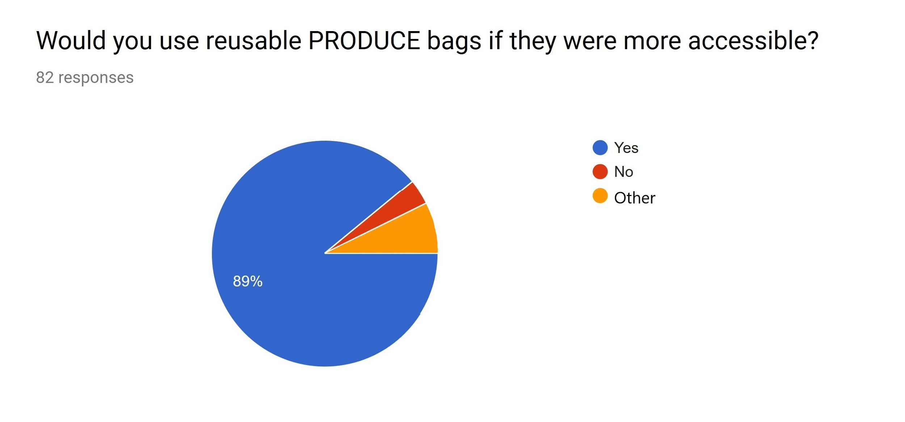
Would you use reusable produce bags if they were more accessible?
3.7%
7.3%

Slide 9
Product
Notes:
Confusion a little bit,
We’re glad to present our solution to this pressing problem.

Slide 10


OUR FEATURES
rPET handles/hooks
rPET drawstring
rPET mesh
rPET fabric

Slide 11
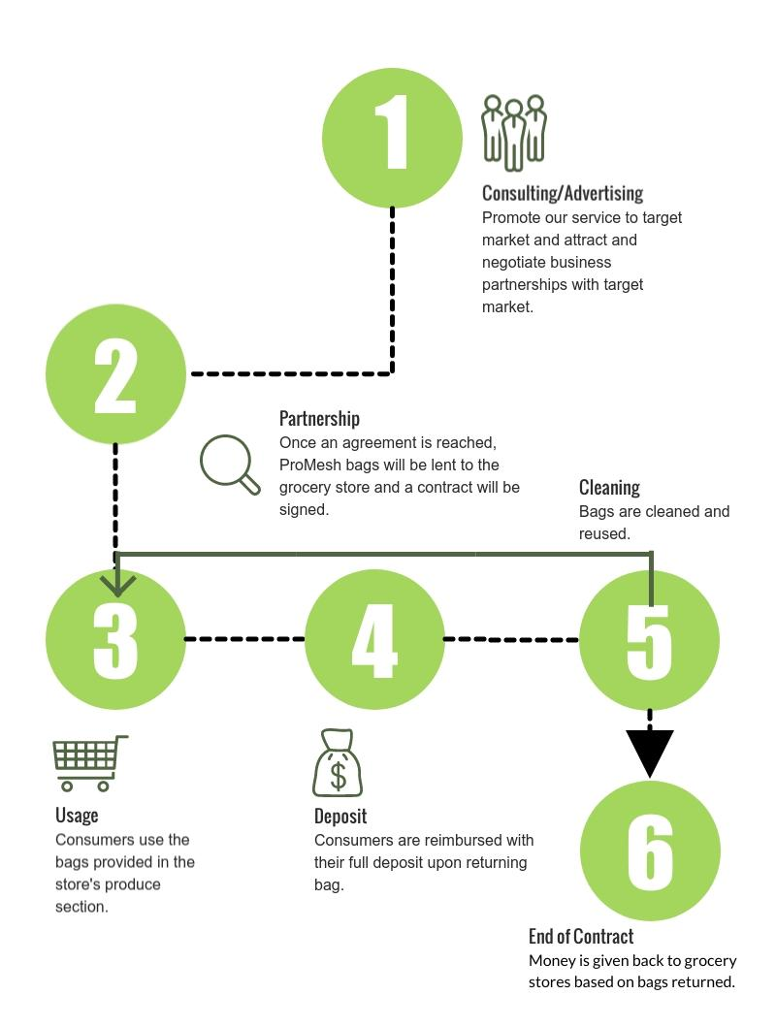
Notes:
Cover each step with a box and

Slide 12
Future Outlook
Future Trends
Critical Timing
3. Evolving Technology
Notes:
The future of the business is very bright as there is a positive outlook on environmentally friendly products. In addition, a popular trend these days is environmentally-friendly products and services. Starting this service at this moment will ensure that when grocery stores are forced to switch to reusable bags, we will have an established brand and a service that these grocery stores can look to partner with. ProMesh also has a convenient operating structure, which means when grocery stores are searching for replacements of plastic produce bags, a contract can be discussed easily and ProMesh bags will be in service relatively fast when compared to other alternatives. The opportunity for growth is relatively timeless, as reducing plastic waste will not be an instant fix. Rather, it will be a process and ProMesh can take advantage of this by expanding our service at this critical window. At this point, if competitors were to enter the market, ProMesh would already have a majority of the market share, and it would be difficult for grocery stores to choose other businesses over ProMesh, as the business has already been operational for multiple years.

Slide 13
Marketing

Slide 14


Narrowing it Down
Chain Size
Profits
3. Environmental Stance

Slide 15
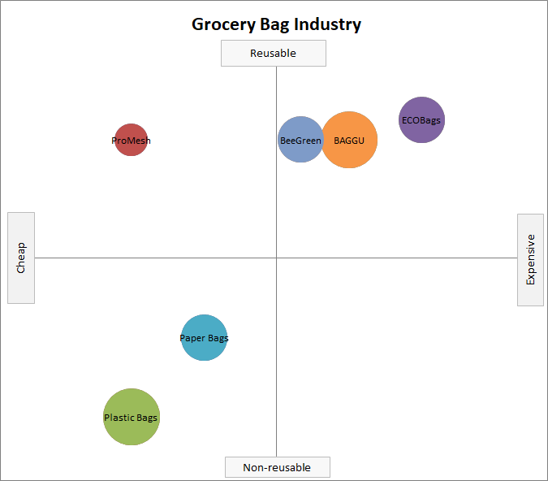
Differentiation

Slide 16
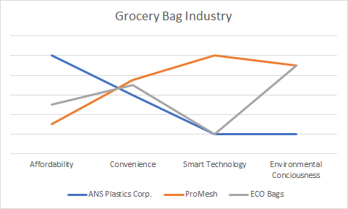
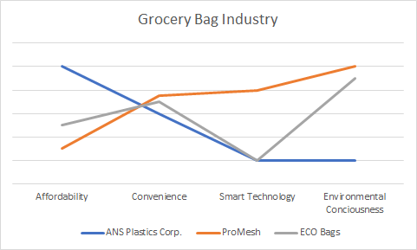
Differentiation
Notes:
Focus
Divergence
Differentiation
Tagline (“Shop smart”)

Slide 17





Partnerships
Collaborative Promotion
Online Sharing

Slide 18
Business Operations
Location
Employees
Office Space
Capacity
Notes:
Our business will be focused in the Ottawa region, with the initial office space located at 1339 Wellington St. W, Ottawa, ON. This is due to the grocery store landscape, as there are many smaller, environmentally conscious grocery stores located in this region, which defines our target market. Ottawa is also a cheaper
Along with the Board of Directors, there will be three main employees we will be hiring for managerial responsibilities, the President, CFO, and Marketing VP. The President will have the most responsibility out of the three, overlooking operations and reporting a monthly overview to the Board of Directors outlining the operations and successes of ProMesh. Other responsibilities will be to overlook the CFO and Marketing VP, and make sure operations are running smoothly. The CFO (Chief Financial Officer) will overlook all financial operations, including cash flow statements and budgeting, and the Marketing VP will overlook all marketing operations, most importantly sales and promotion. These employees will ideally be employed at another location and looking for new leadership opportunities. During the first year, the job will be part time, and as ProMesh grows as a business, these positions will be converted to a full time position to overlook the expansion of the business.
In the initial startup phase, space for production will not be needed as we will be outsourcing the production of our ProMesh bags to another producer. The simple reason for this is due to production costs, and in the initial phase, we are just trying to expand our business as much as possible and producing our own bags will be too expensive. However, if we reach a point where our revenue can sustain our own production, investing in our own production facility can be entirely feasible and is something worth considering since it will reduce costs related to transportation of our mesh bags. In terms of space for our employees, we will be investing in a smaller office space for our employees due to the limited number of employees we will have during the startup phase. The space, as mentioned earlier, will be located at 1339 Wellington St. W, Ottawa, ON ³. This is a 1,000 ft² office space with two private office spaces and plenty of open space for more employees. The rent cost will be $1,000 per month, which equates to around $12.00/sf/yr. This office space will be optimal for the startup phase of the business as it is a relatively cheap office space which provides the basic functions for the operations of ProMesh.
In our first year, we will be aiming for a minimum of 5 grocery stores to use our service, and ideally up to 10. The reason we can provide this capacity is due to the simple nature of our service. These mesh bags, while very durable, are relatively cheap and easy to produce in large quantities. This means we can constantly supply our bags to our clients at a fast rate, and therefore are able to provide our service to up to 10 grocery stores. Another aspect which allows us to have this capacity is that our operations are fairly limited. Our main operation is shipping our bags to each of these stores. We will be supplying a washing machine for these bags that customers bring back, and there is no complicated process which requires employees or machinery. Therefore, we can streamline our process and provide our service to many clients at the same time.

Slide 19
FINANCIAL PLAN

Slide 20
PRICING SYSTEM
CONTRACT FEE
$1250
SOURCES OF REVENUE
DEPOSIT OF $1.25 per Bag
PRODUCTION COST OF $0.80

Slide 21
STARTUP AND FUNDING
01
OWNERSHIP INVESTMENT
02
PRIVATE INVESTMENT
03
LONG-TERM LOANS

Slide 22
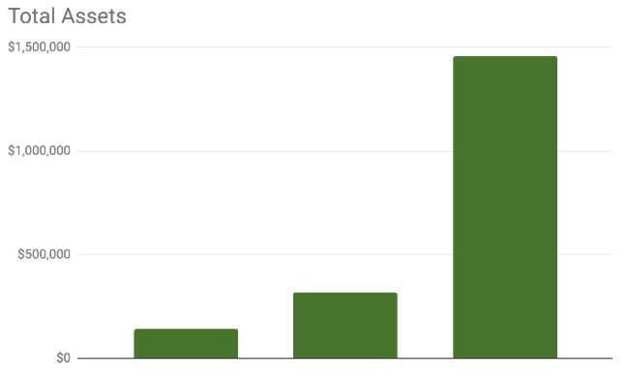
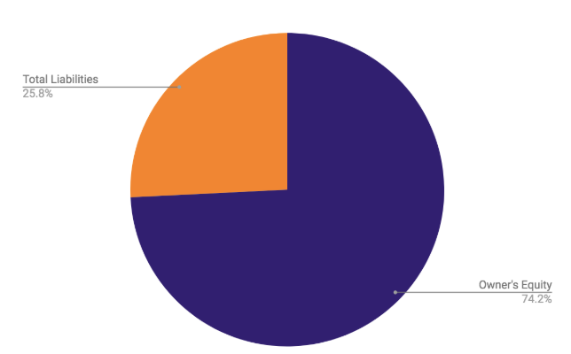
BALANCE SHEET
Current Ratio | 1.79 | 1.07 | 2.92
Working Capital | $29,528 | $6,728 | $666,650

Slide 23
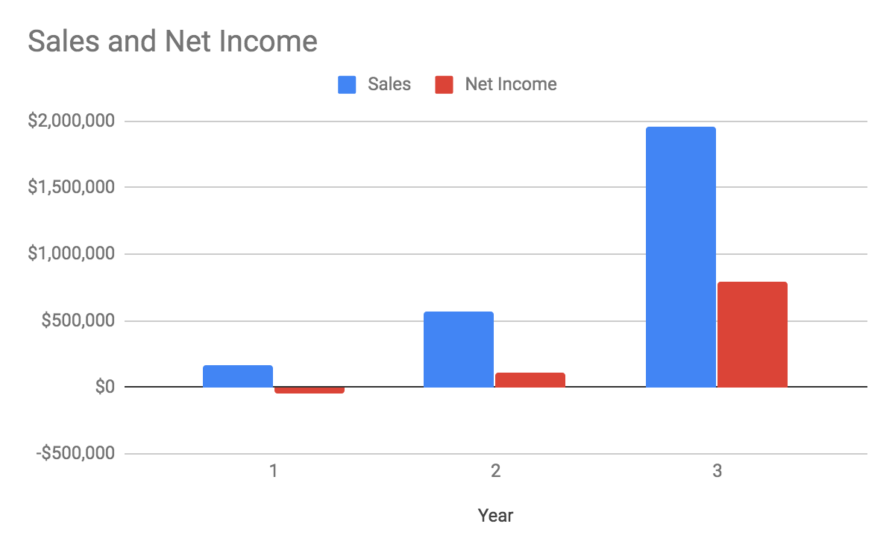
INCOME STATEMENT
Notes:
Add a good conclusion at the end of this.

Slide 24


Questions
@promeshcompany promesh2019@gmail.com
Notes:
Simple yet viable solution that we think that will “impactfully reduce Canada’s waste”

